Slide 1


PARTNER PRESENTATION: MAKING THE BUSINESS CASE
This presentation as is an editable template for Guardians of Grub partners to make the business case for tackling wasted food to teams and colleagues
It provides the business case to get teams on board by explaining:
  why wasted food is an issue
  why teams should care
  how to take action
  the free Guardians of Grub resources that are available to help
Pages are editable so feel free to add logos and change text. Some slides have a suggested script in the presenter notes
Please send any feedback to guardiansofgrub@wrap.org.uk

Slide 2
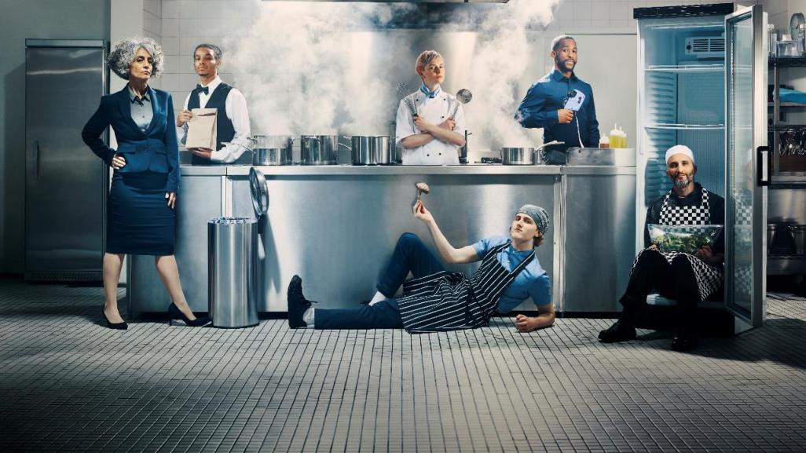

Helping Us to Rise Up Against Food Waste
guardiansofgrub.com #GuardiansOfGrub

Slide 3



TAKE A STAND AGAINST WASTED FOOD
We can all be Guardians of Grub and make wasted food a thing of the past. Using Guardians of Grub tools will help to:
  Protect your profit
  Protect our planet
  Feed people not bins
This presentation will explain why we should care about wasted food, what we can do to tackle it and the how the Guardians of Grub resources can help.
Notes:
Seeing good food go in the bin doesn’t just make sense. It wastes time and energy taken up ordering, putting away, prepping and serving food that ends up being wasted.
This presentation will explain why we should care about food waste, what we can do to tackle it and the resources that Guardians of Grub have to help.

Slide 4

WHY DOES IT MATTER?
For every
2 tonnes
of food we eat, another
tonne
is wasted

Slide 5
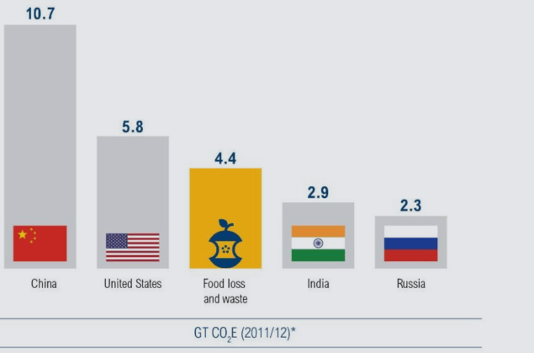

IF FOOD LOSS AND WASTE WERE A COUNTRY…
WHY DOES IT MATTER?
…it would be
the 3rd largest
greenhouse gas emitter
Notes:
We know that across the globe, food waste is a problem
One third of all food is wasted.
We throw away food whilst 1 in 9 people go hungry.
We throw away food which contributes to climate change.
We throw away food that wastes money on the bottom line.
Food waste impacts on people, the planet and profit, and we are here today to take action to change this.

Slide 6
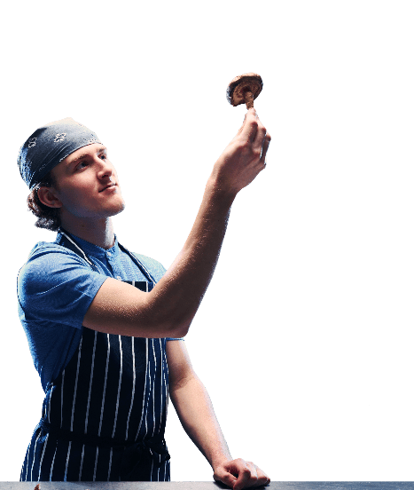
The UK’s hospitality and food service sector throws away
1.1 million tonnes of food each year, of which 75% is avoidable.
WHY DOES IT MATTER?
*Stats provided by WRAP
Notes:
WRAP research highlights that around 18% of food that is purchased in the sector is thrown away.
13.2% of the food purchased in our sector is avoidable. That means IT COULD HAVE BEEN EATEN.
That means there is a huge opportunity to reduce the amount of food thrown away but also to make better use our planet’s precious resources.

Slide 7

Each year food waste costs our industry
WHY DOES IT MATTER?
£3.2 billion

Slide 8
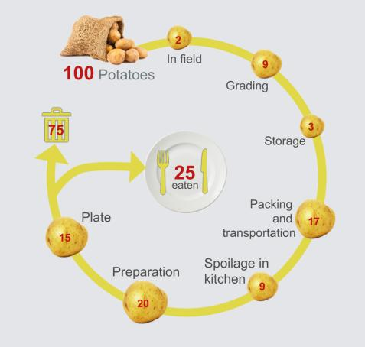
75% OF POTATOES ARE LOST THROUGHOUT THE FOOD JOURNEY…
WHY DOES IT MATTER?
36
POTATOES ARE THROWN AWAY BEFORE THEY
REACH
THE HOTEL
44
POTATOES ARE THROWN AWAY AT THE HOTEL
*Stats provided by WRAP

Slide 9
HOW MUCH FOOD WASTE COSTS
PER PLATE / COVER
WHY DOES IT MATTER?
Type of food service outlet | Average cost of avoidable food waste per cover | Cost per year (£)
 |  | 500 covers per week | 1000 covers per week | 1500 covers per week
Restaurants | £0.97 | 25,220 | 50,440 | 75,660
Hotels | £0.52 | 13,520 | 27,040 | 40,560
Leisure | £0.46 | 11,960 | 23,360 | 35,880
Services | £0.43 | 11,180 | 22,360 | 33,540
Pubs | £0.41 | 10,660 | 21,320 | 31,980
Healthcare | £0.22 | 5,720 | 11,440 | 17,160
Education | £0.22 | 5,720 | 11,440 | 17,160
Quick Service Restaurants | £0.14 | 3,640 | 7,280 | 10,920

Slide 10
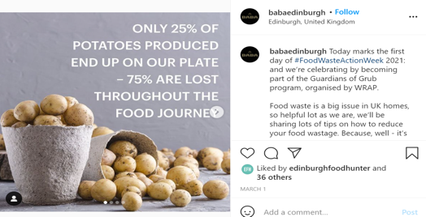
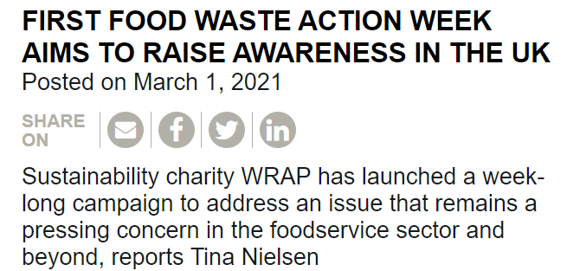
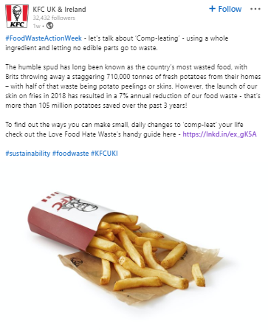
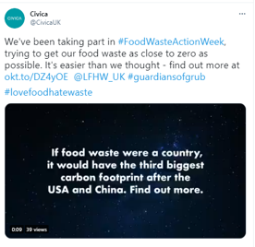

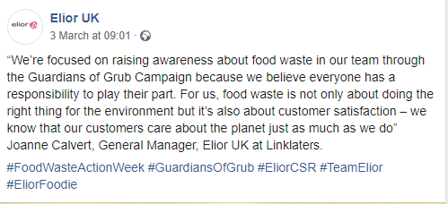
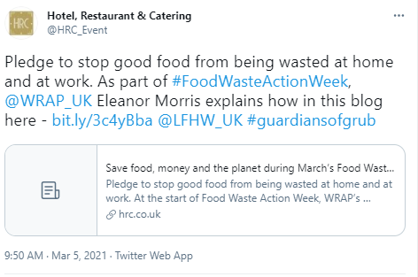
IT’S IMPORTANT TO OUR CUSTOMERS
WHY DOES IT MATTER?

Slide 11
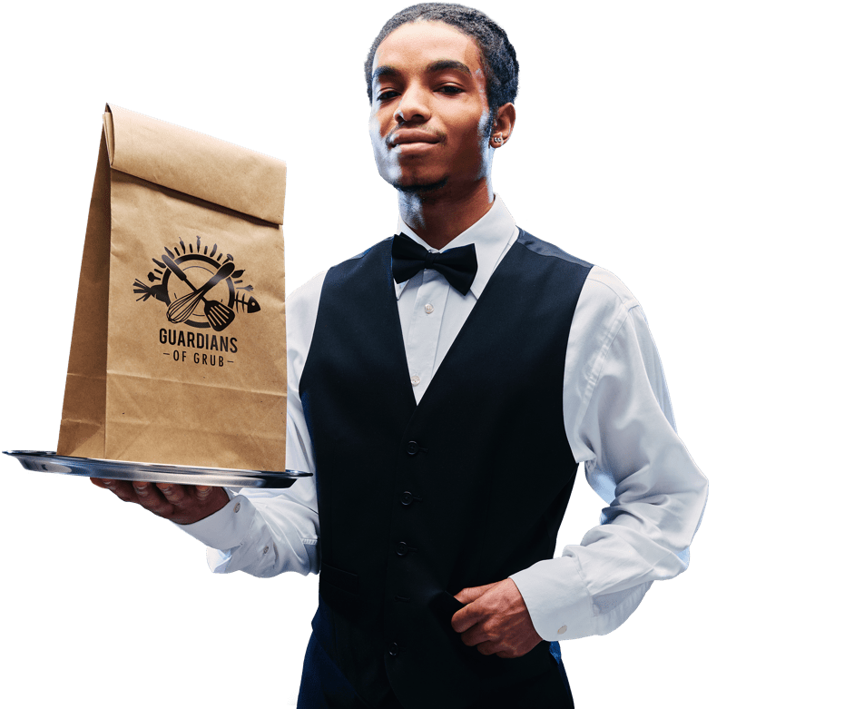
IT’S IMPORTANT TO OUR CUSTOMERS
WHY DOES IT MATTER?
81% of the UK population care about the climate crisis and 32% see a link between food waste and the environment.
Furthermore, the most recent FSA Consumer tracker shows that after food safety, 57% of people believe the next most important issue is food waste.
*Source: WRAP, 2020, Banbury, Trends Survey 2020, Prepared by WRAP
**Source: FSA’s Public Attitudes Tracker Survey Wave 19 results published

Slide 12


WHY DOES IT MATTER?
Notes:
This video shows why it’s time for our industry to rise up against food waste.
WRAP has created a campaign called Guardians of Grub to
encourage the entire Hospitality and Food Service industry
to come together to eradicate food waste once and for all.
The campaign aims to spur businesses into action and
reduce annual food waste throughout our industry.
Success lies in our hands.

Slide 13
WHAT WE CAN DO TO TACKLE FOOD WASTE
WHAT CAN
YOU DO?
Find out how much money and carbon equivalent we could be saving over a year by reducing wasted food with the simple calculator tool – all you need is estimated cover numbers
Commit to Target, Measure, Act. Set a Target for reducing food waste, start Measuring your waste, then Act to tackle it. A 20% reduction Target is a good place to start
Get our staff on board by explaining why the organisation is reducing food waste. The 15-minute Cost Saving Skills course, 90 second video, posters and the Getting Started Guide can help
Make sure all our staff understand what they need to do with food waste during the review. Put up posters, and use social media to get people excited
Find a Guardian of Grub Champion to drive the process on site but make sure all staff understand what is happening during the review and can take part
To capture the food thrown away, set out separate containers for Spoilage, Preparation, Plate and ‘Other’. Label the containers so that staff know where to put the food – everything you need is in the 15-minute Cost Saving Skills course
Weigh the containers and record each type of food thrown away each day on the 7 day tracking sheet

Slide 14
WHAT WE CAN DO TO TACKLE FOOD WASTE
WHAT CAN
YOU DO?
Input your figures into the Food Tracking Calculator or Unilever Food Solutions’ free Wise Up on Waste. They calculates how much wasted food is costing you and shows the potential savings your business could make over a year
Share Tracking calculator figures confidentially with WRAP at guardiansofgrub@wrap.org.uk
Work through the Summary Checklist
Review your waste figures with staff weekly and make talking about ways to save food a regular topic of staff meetings. Get staff thinking about where your waste comes from, and why, and make sure everyone feels they can take part. Show the charts from the Food Tracking Calculator
Plan actions to reduce the amount of food your business throws away. Tonnes of ideas and inspiration for food saving tips can be found in 6 Ways to Save Food, case studies, the food saving masterclasses and the 15-min Cost Saving Skills course. Record these actions in your Food Waste Reduction Action Plan and keep track of their progress.
Go public and talk about your savings and successes – and consider signing up to the UK Food Waste Reduction Roadmap and Courtauld Commitment 2025

Slide 15

Website: guardiansofgrub.com
Operational resources: tools, tips and training to help us with the nuts and bolts of measuring and reducing food waste
Campaign toolkit: to help us share Guardians of Grub with staff, customers and the public
Subscribe on the website to receive regular updates from the Guardians of Grub newsletter
A QUICK PEEK AT SOME OF THE
GUARDIANS RESOURCES
RESOURCES
Click on the image for the Cost Saving Calculator preview video

Slide 16

Just input real or estimated cover numbers to see how much money and carbon equivalent can be saved in four clicks of a mouse! https://guardiansofgrub.com/cost-saving-calculator/
NEW GUARDIANS OF GRUB
COST SAVING CALCULATOR
RESOURCES
Click on the image for the Cost Saving Calculator preview video

Slide 17

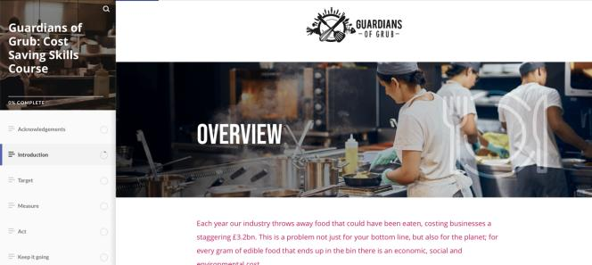
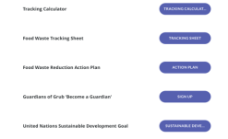
Provides the skills to get started.
NEW GUARDIANS OF GRUB
COST SAVING SKILLS COURSE
RESOURCES
Notes:
The Cost Savings Skills Course which will your staff all the basic information they need in just fifteen minutes.

Slide 18
And here’s what people are saying about the course…
NEW GUARDIANS OF GRUB
COST SAVING SKILLS COURSE
RESOURCES
“Steps are simple
and clear.”
“Every subheading was broken down and explained and easy to follow, leaving you feeling motivated.”
“Highly engaging. Each section
was an appropriate length to retain my attention. I particularly like the case studies showing practical applications.”
“Very succinct and practical.”

Slide 19

Knowledge is power! Guardians of Grub:
Becoming a Champion course is a behaviour change programme ideal for those organisations committed to taking action through a combination of learning and food waste measurement.
Participants have access to:
- Certificates
- Resource Toolkit of templates and how to guides
This course will take your skills to the next level and make a positive difference to you, your profits and the planet. If you’re a business that wants to take part, contact guardiansofgrub@wrap.org.uk.
NEW GUARDIANS OF GRUB
BECOMING A CHAMPION COURSE
RESOURCES
“I am really impressed with the quality of the Guardians of Grub: Becoming a Champion training materials. I am enjoying the online course, and find the case studies and podcasts inspirational, you can’t beat hearing success stories from industry experts and respected chefs and businesses. The savings on the bottom line and positive impacts on sustainability are there for the whole industry to maximise, Guardians of Grub is a great platform to get involved and get results”
Marten Lewis – Bluestone
“Using the Becoming a Champion tools, I have taken staff through a short introduction and they are responding very positively. All the information is very straightforward, easy to understand and it’s adaptable to the way we work here. I can show staff our measurements of the wasted food we collect and it will lead to behaviour change, it’s as simple as that.”
Cameron White – Assistant Catering Manager, Betty’s

Slide 20
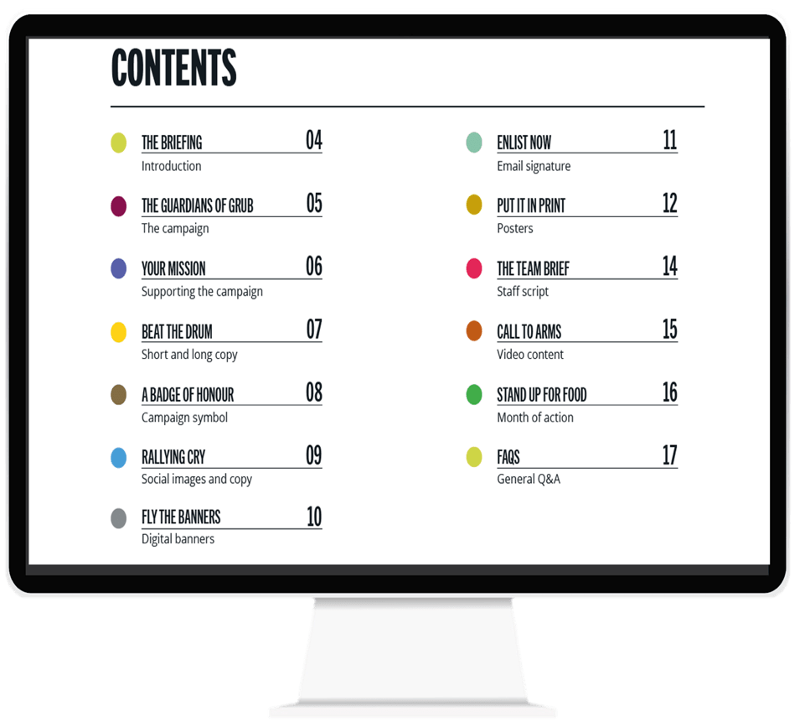

GETTING STARTED GUIDE
RESOURCES
Notes:
This guide will give you the the tools you need to identify hotspots and could save your business money.

Slide 21

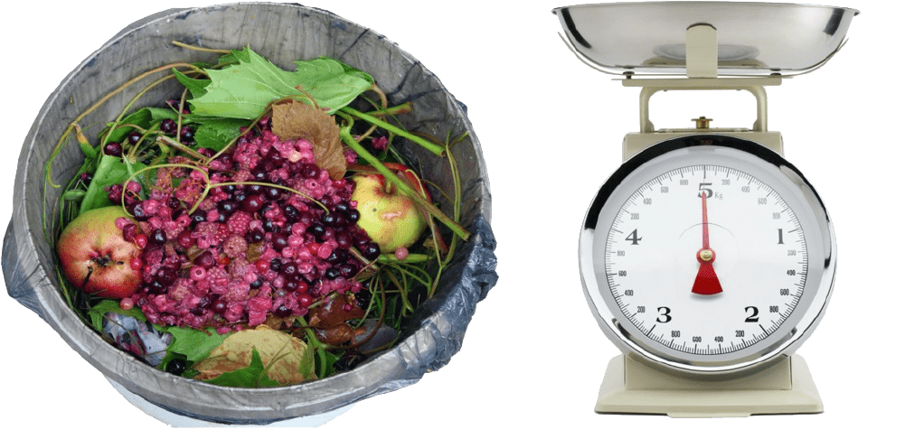

WHAT WE NEED TO START MEASURING:
CONTAINERS, BAGS AND SCALES
RESOURCES
Notes:
Clear bags can help people to see what’s being thrown away
Four buckets/bins for collecting each waste type don’t need to be bought new
Label the four buckets as follows:
PREPARATION
Food that is thrown away during preparation, such as offcuts.
SPOILAGE
Food that’s damaged or out of date, such as vegetable spoilage.
PLATE WASTE
Food that is left on plates such as chips and garnishes.
OTHER
Other types of food thrown away, such as food that is ready to serve but not eaten, e.g. over production, buffet.
Luggage scales or bathroom scales can be used to weight the buckets/bags.

Slide 22
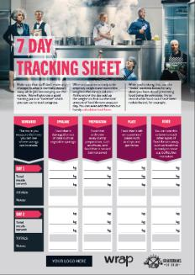
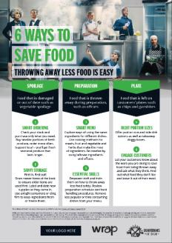
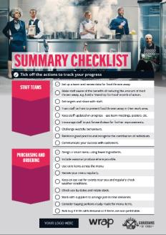
PLACE 7 DAY TRACKING SHEET BY FOOD WASTE CONTAINERS FOR EASY LOGGING.
DISPLAY TIPS AND CHECKLIST.
RESOURCES
Notes:
Use these posters and tracking sheets all freely available from guardiansofgrub.com you can even add your logo

Slide 23
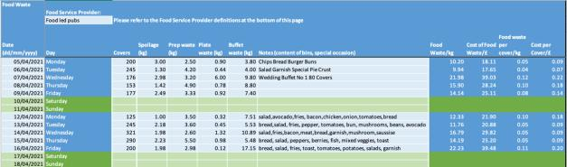
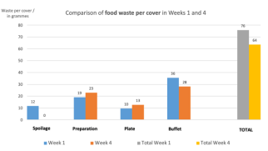
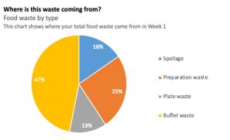
Excel spreadsheet for daily data which calculates:
- where waste is coming from – plate, prep, spoilage, other
- how much it is costing per cover, per week, month and year
GUARDIANS OF GRUB
FOOD TRACKING CALCULATOR
RESOURCES
Add your data to the Guardians of Grub Tracking Calculator
or the Unilever Food Solutions
Wise Up On Waste online tool.
Notes:
Add in the data from your Tracking Sheet to the 4 week calculator or Wise Up On Waste tool www.wiseuponwaste.com to help visualize the hotspots and savings with your team

Slide 24

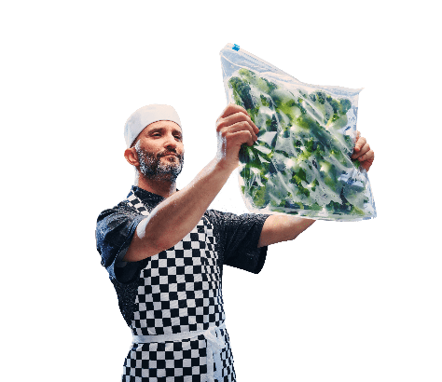
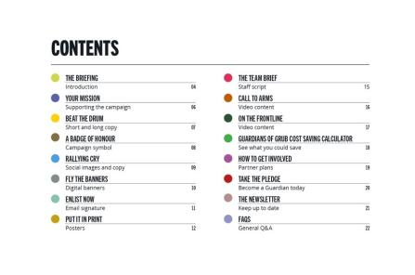
THE CAMPAIGN TOOLKIT:
SOCIAL MEDIA, POSTERS, COPY
RESOURCES

Slide 25



CAMPAIGN TOOLKIT: POSTERS FOR DISPLAYING
ON SITE AND USING ON SOCIAL MEDIA
RESOURCES

Slide 26


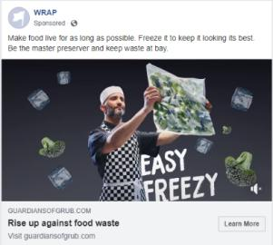
CAMPAIGN TOOLKIT: SHORT VIDEOS FOR
SOCIAL AND COMMS CHANNELS
RESOURCES

Slide 27
Inspiring examples of food waste reduction in action where small changes have made big savings.
EXAMPLES
& IMPACT
CAMPAIGN TOOLKIT: CASE STUDIES
CASE STUDIES
EXAMPLES
& IMPACT
Notes:
There are tonnes of case studies on the Guardians of Grub website to help with food saving ideas and inspiration

Slide 28

SMALLER PORTIONS, HAPPIER CUSTOMERS
& 72% LESS WASTE
EXAMPLES
& IMPACT
Measuring food waste at the Ship Inn, Cumbria led to an:
  84% reduction in spoilage as awareness changed practices
  80% reduction in prep waste, mainly as a result of switching to
  pre-prepared vegetables and pre-cut chips
  67% reduction in plate waste through offering smaller portion sizes, particularly of chips and sauces, and removing some garnishes
  Estimated £6,040 of savings over the year
“The savings you make over a year, the improved experience of customers and better understanding and skills of kitchen staff really make this worth doing. You might think you don’t have the time… but you do. Once you get the buckets in the kitchen and brief the staff it really doesn’t take much time at all.”
Dave, Licensee

Slide 29

MEASURING HELPS COUNTRY PUB
SAVE £11,000* PER YEAR
EXAMPLES
& IMPACT
Measuring at The Harrington Arms, Gawsworth, led to a:
48% reduction in spoilage from tighter ordering, more manager oversite and buying smaller quantities.
31% reduction in prep waste – mainly from switching from a knife to a peeler and buying pre-prepped
28% reduction in plate waste from controlling portions more tightly,
particularly chips, and offering smaller portion sizes of mains which elderly customers appreciated
“This was a good exercise with perfect timing. My advice to other pubs is definitely do it. The key is to enrol in the staff – it needs to be sold in the right way.”
Andy Wightman, Licensee
*Estimated true cost of food waste to the business, including associated costs such as energy used in cooking and storage, staff time, waste disposal and water.

Slide 30
WHAT IS OUR COMMITMENT TO TAKE ACTION ON WASTED FOOD?
Step 1. As a business, we will join* the campaign at guardiansofgrub.com by signing the pledge and downloading the free resources and tools to measure our food waste and shout about how and why we support the Guardians of Grub campaign.
Step 2. We will appoint a Guardians of Grub Champion and will regularly review our food waste figures. We will share our learnings on reducing wasted food and support Guardians of Grub to rise up against food waste.
Step 3. We commit to setting a food waste reduction target, measuring and taking action to reduce our wasted food. We will get our kitchens briefed and set up to measure using Guardians of Grub operational resources and will use the Campaign Guide to encourage others to take part.
* WRAP will share hints, tips and advice for reducing our food waste as well as exclusive content and support.

Slide 31

guardiansofgrub.com #GuardiansOfGrub guardiansofgrub@wrap.org.uk

